Slide 1
Introduction
“One picture is worth more than ten thousand words”
Anonymous
Notes:
1

Slide 2
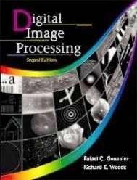
References
“Digital Image Processing”, Rafael C. Gonzalez & Richard E. Woods, Addison-Wesley, 2002
Much of the material that follows is taken from this book
Notes:
2

Slide 3
Contents
This lecture will cover:
What is a digital image?
What is digital image processing?
History of digital image processing
State of the art examples of digital image processing
Key stages in digital image processing
Notes:
3

Slide 4
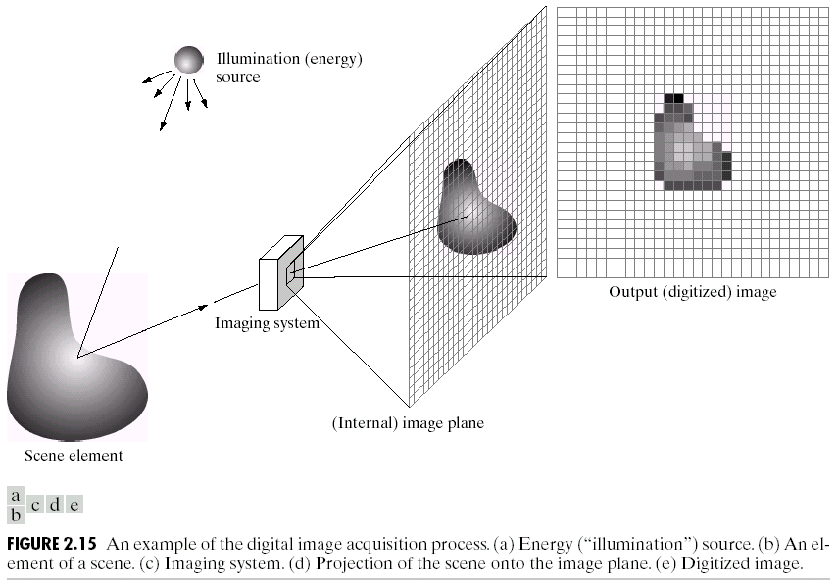

What is a Digital Image?
A digital image is a representation of a two-dimensional image as a finite set of digital values, called picture elements or pixels
Images taken from Gonzalez & Woods, Digital Image Processing (2002)
Notes:
4
Real world is continuous – an image is simply a digital approximation of this.

Slide 5
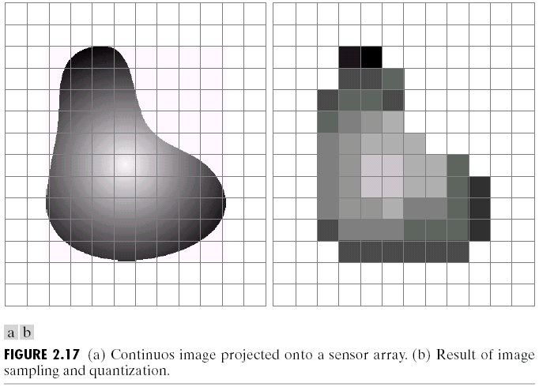
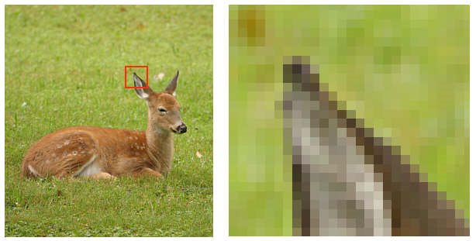
What is a Digital Image? (cont…)
Pixel values typically represent gray levels, colours, heights, opacities etc
Remember digitization implies that a digital image is an approximation of a real scene
Images taken from Gonzalez & Woods, Digital Image Processing (2002)
1 pixel
Notes:
5

Slide 6
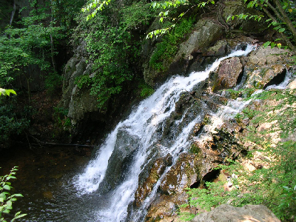

What is a Digital Image? (cont…)
Common image formats include:
1 sample per point (B&W or Grayscale)
3 samples per point (Red, Green, and Blue)
4 samples per point (Red, Green, Blue, and “Alpha”, a.k.a. Opacity)
For most of this course we will focus on grey-scale images
Notes:
6

Slide 7
What is Digital Image Processing?
Digital image processing focuses on two major tasks
Improvement of pictorial information for human interpretation
Processing of image data for storage, transmission and representation for autonomous machine perception
Some argument about where image processing ends and fields such as image analysis and computer vision start
Notes:
7

Slide 8
What is DIP? (cont…)
The continuum from image processing to computer vision can be broken up into low-, mid- and high-level processes
Low Level Process
Mid Level Process
High Level Process
Input: Image Output: Image
Examples: Noise removal, image sharpening
Input: Image Output: Attributes
Examples: Object recognition, segmentation
Input: Attributes Output: Understanding
Examples: Scene understanding, autonomous navigation
In this course we will stop here
Notes:
8
Give the analogy of the character recognition system.
Low Level: Cleaning up the image of some text
Mid level: Segmenting the text from the background and recognising individual characters
High level: Understanding what the text says

Slide 9
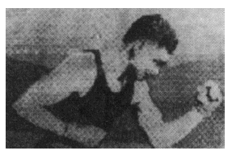
History of Digital Image Processing
Early 1920s: One of the first applications of digital imaging was in the news- paper industry
The Bartlane cable picture transmission service
Images were transferred by submarine cable between London and New York
Pictures were coded for cable transfer and reconstructed at the receiving end on a telegraph printer
Early digital image
Images taken from Gonzalez & Woods, Digital Image Processing (2002)
Notes:
9

Slide 10
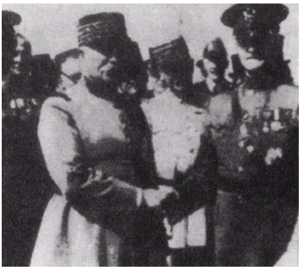
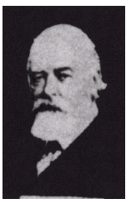
History of DIP (cont…)
Mid to late 1920s: Improvements to the Bartlane system resulted in higher quality images
New reproduction processes based on photographic techniques
Increased number of tones in reproduced images
Images taken from Gonzalez & Woods, Digital Image Processing (2002)
Improved digital image
Early 15 tone digital image
Notes:
10

Slide 11
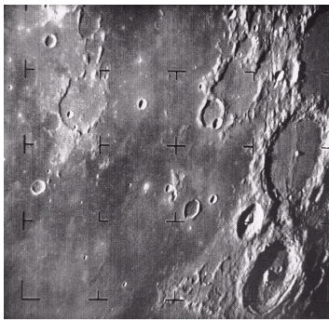
History of DIP (cont…)
1960s: Improvements in computing technology and the onset of the space race led to a surge of work in digital image processing
1964: Computers used to improve the quality of images of the moon taken by the Ranger 7 probe
Such techniques were used in other space missions including the Apollo landings
Images taken from Gonzalez & Woods, Digital Image Processing (2002)
A picture of the moon taken by the Ranger 7 probe minutes before landing
Notes:
11

Slide 12
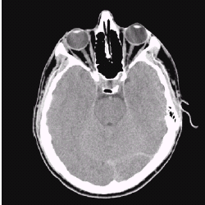
History of DIP (cont…)
1970s: Digital image processing begins to be used in medical applications
1979: Sir Godfrey N. Hounsfield & Prof. Allan M. Cormack share the Nobel Prize in medicine for the invention of tomography, the technology behind Computerised Axial Tomography (CAT) scans
Images taken from Gonzalez & Woods, Digital Image Processing (2002)
Typical head slice CAT image
Notes:
12

Slide 13
History of DIP (cont…)
1980s - Today: The use of digital image processing techniques has exploded and they are now used for all kinds of tasks in all kinds of areas
Image enhancement/restoration
Artistic effects
Medical visualisation
Industrial inspection
Law enforcement
Human computer interfaces
Notes:
13

Slide 14
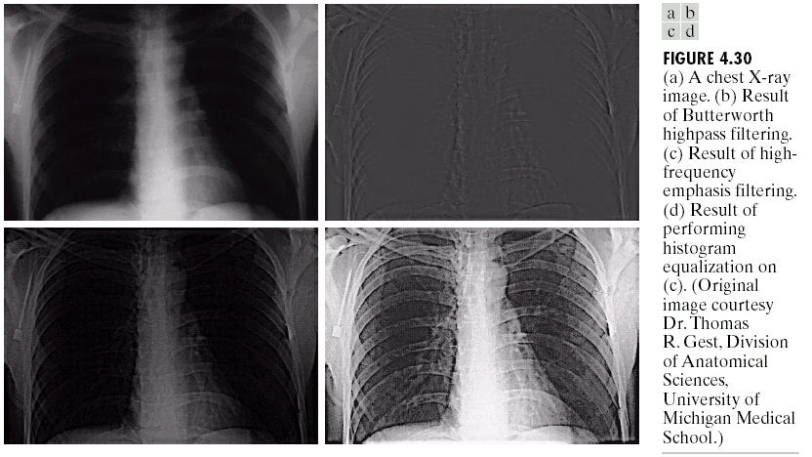
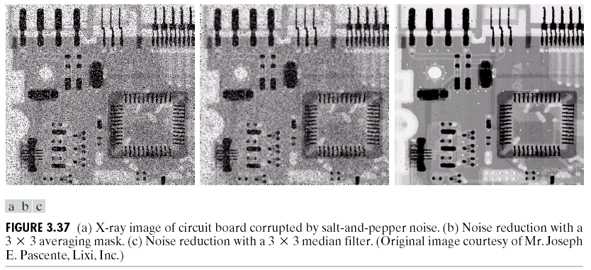
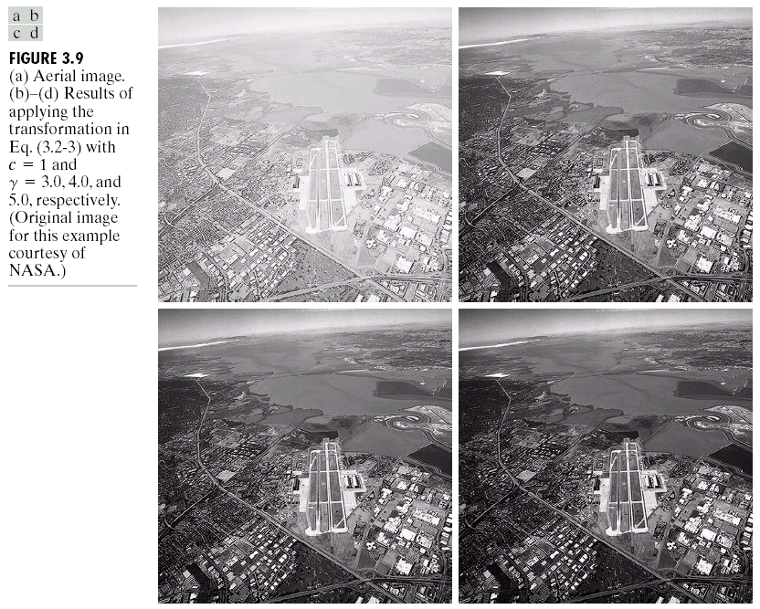
Examples: Image Enhancement
One of the most common uses of DIP techniques: improve quality, remove noise etc
Images taken from Gonzalez & Woods, Digital Image Processing (2002)
Notes:
14

Slide 15
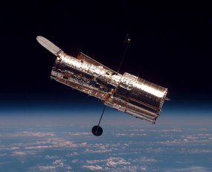
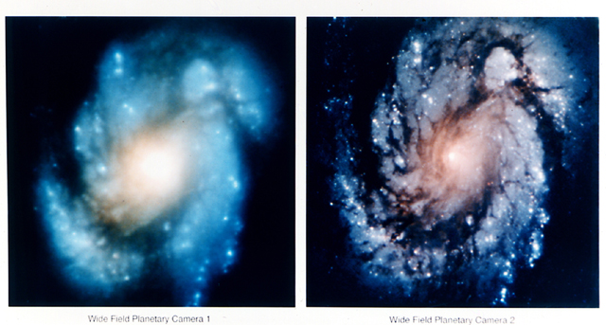
Examples: The Hubble Telescope
Launched in 1990 the Hubble telescope can take images of very distant objects
However, an incorrect mirror made many of Hubble’s images useless
Image processing techniques were used to fix this
Notes:
15

Slide 16
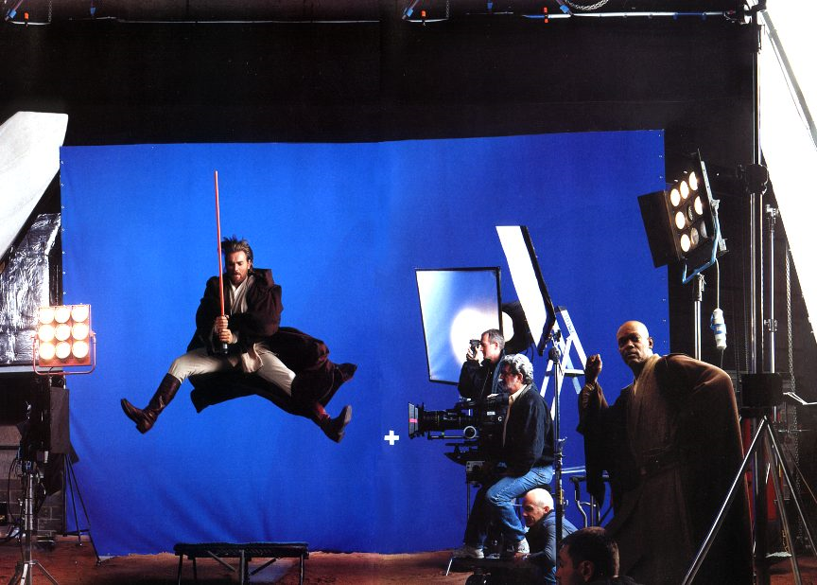

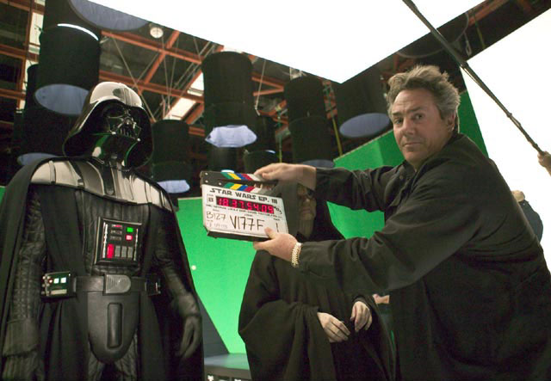
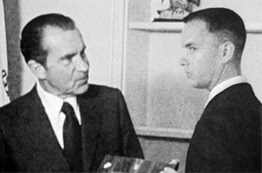
Examples: Artistic Effects
Artistic effects are used to make images more visually appealing, to add special effects and to make composite images
Notes:
16

Slide 17
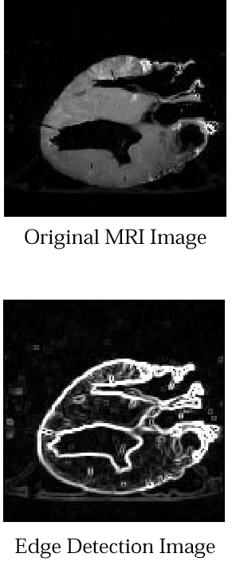
Examples: Medicine
Take slice from MRI scan of canine heart, and find boundaries between types of tissue
Image with gray levels representing tissue density
Use a suitable filter to highlight edges
Images taken from Gonzalez & Woods, Digital Image Processing (2002)
Original MRI Image of a Dog Heart
Edge Detection Image
Notes:
17

Slide 18
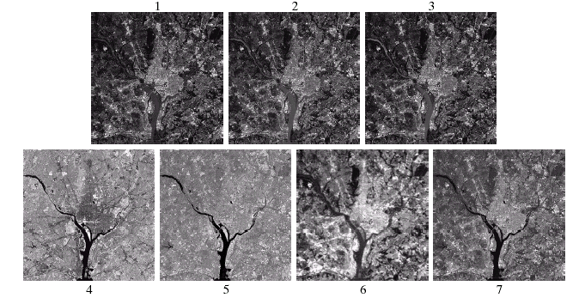
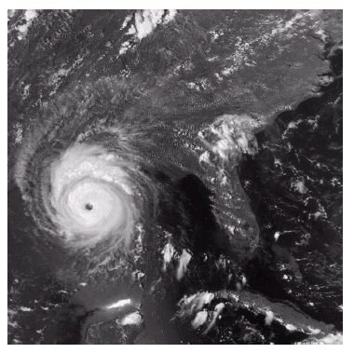
Examples: GIS
Geographic Information Systems
Digital image processing techniques are used extensively to manipulate satellite imagery
Terrain classification
Meteorology
Images taken from Gonzalez & Woods, Digital Image Processing (2002)
Notes:
18

Slide 19
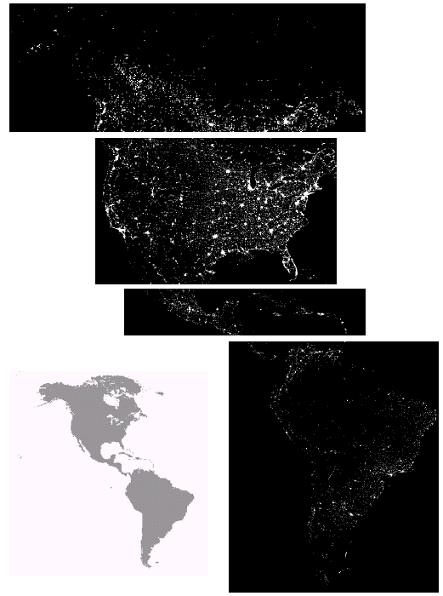
Examples: GIS (cont…)
Night-Time Lights of the World data set
Global inventory of human settlement
Not hard to imagine the kind of analysis that might be done using this data
Images taken from Gonzalez & Woods, Digital Image Processing (2002)
Notes:
19

Slide 20
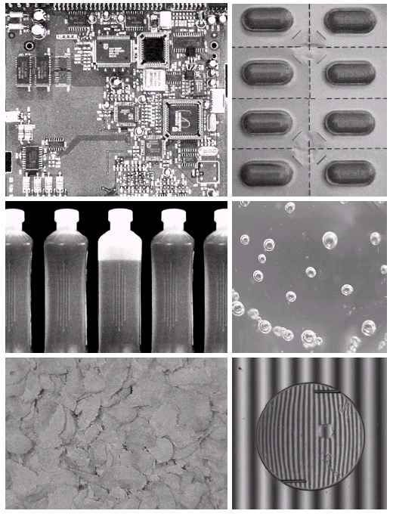
Examples: Industrial Inspection
Human operators are expensive, slow and unreliable
Make machines do the job instead
Industrial vision systems are used in all kinds of industries
Can we trust them?
Images taken from Gonzalez & Woods, Digital Image Processing (2002)
Notes:
20

Slide 21
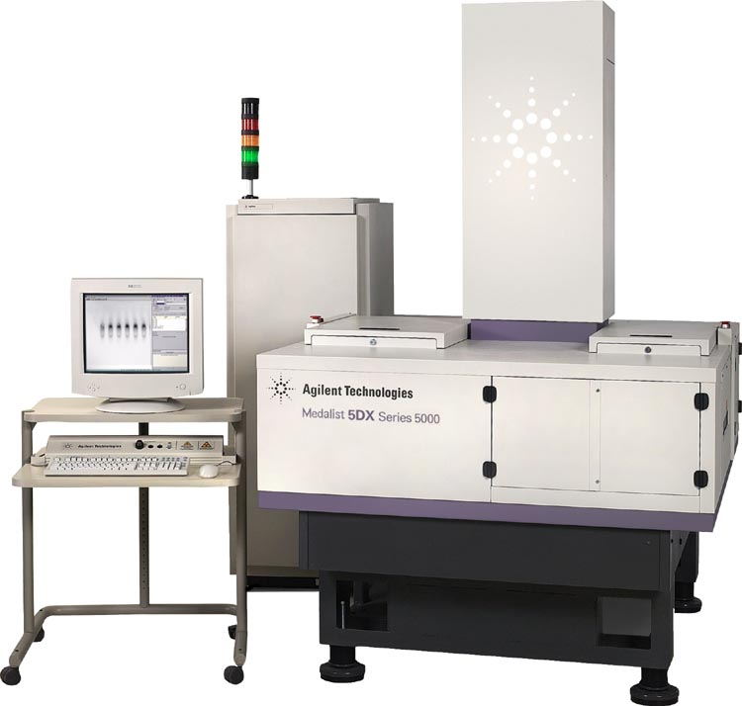
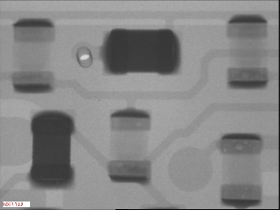
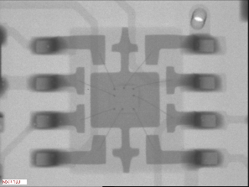
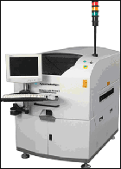
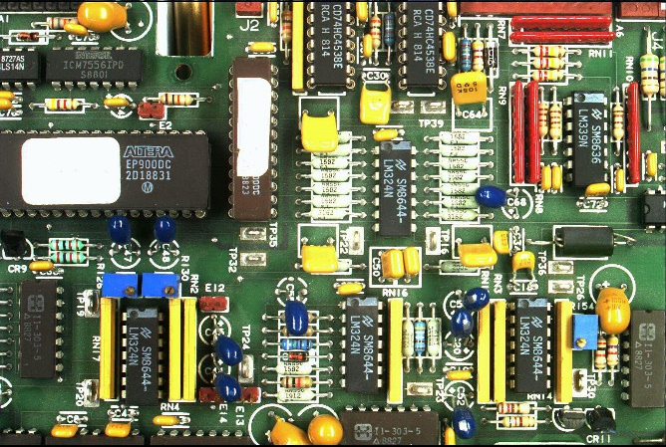
Examples: PCB Inspection
Printed Circuit Board (PCB) inspection
Machine inspection is used to determine that all components are present and that all solder joints are acceptable
Both conventional imaging and x-ray imaging are used
Notes:
21

Slide 22
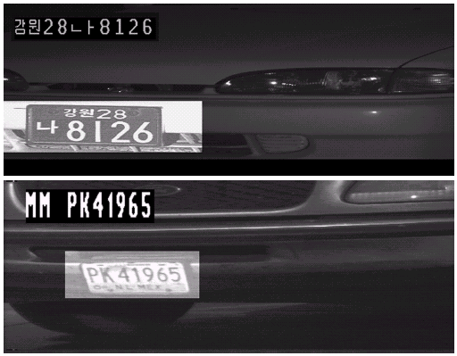
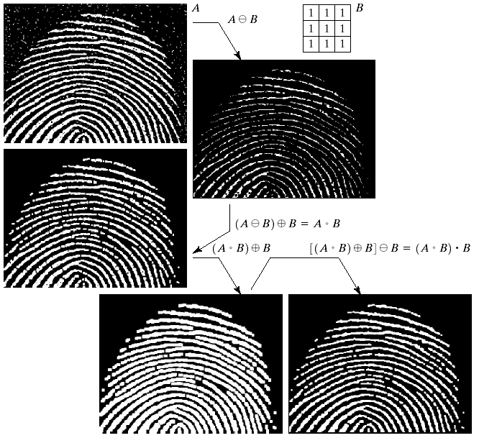
Examples: Law Enforcement
Image processing techniques are used extensively by law enforcers
Number plate recognition for speed cameras/automated toll systems
Fingerprint recognition
Enhancement of CCTV images
Images taken from Gonzalez & Woods, Digital Image Processing (2002)
Notes:
22

Slide 23
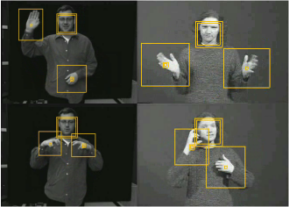
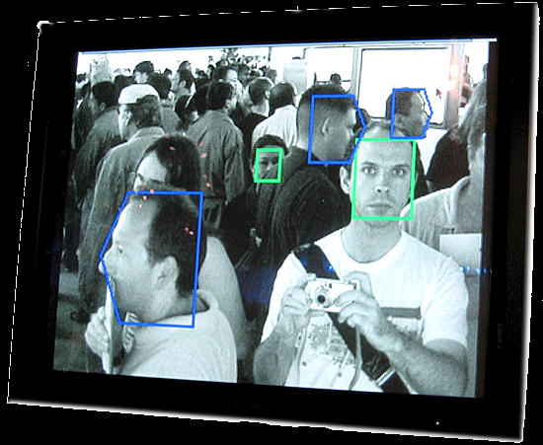

Examples: HCI
Try to make human computer interfaces more natural
Face recognition
Gesture recognition
Does anyone remember the user interface from “Minority Report”?
These tasks can be extremely difficult
Notes:
23

Slide 24
Key Stages in Digital Image Processing
Image Restoration
Morphological Processing
Image Enhancement
Segmentation
Image Acquisition
Object Recognition
Representation & Description
Problem Domain
Colour Image Processing
Image Compression
Notes:
24

Slide 25
Key Stages in Digital Image Processing: Image Aquisition
Image Restoration
Morphological Processing
Image Enhancement
Segmentation
Image Acquisition
Object Recognition
Images taken from Gonzalez & Woods, Digital Image Processing (2002)
Representation & Description
Problem Domain
Colour Image Processing
Image Compression
Notes:
25

Slide 26
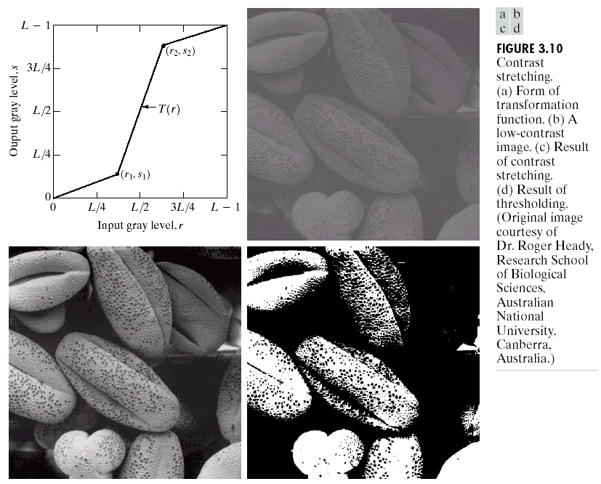
Key Stages in Digital Image Processing: Image Enhancement
Image Restoration
Morphological Processing
Image Enhancement
Segmentation
Image Acquisition
Object Recognition
Images taken from Gonzalez & Woods, Digital Image Processing (2002)
Representation & Description
Problem Domain
Colour Image Processing
Image Compression
Notes:
26

Slide 27
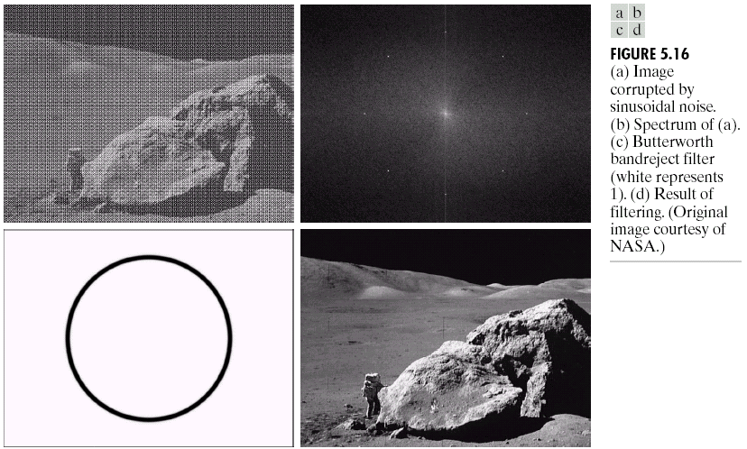
Key Stages in Digital Image Processing: Image Restoration
Image Restoration
Morphological Processing
Image Enhancement
Segmentation
Image Acquisition
Object Recognition
Images taken from Gonzalez & Woods, Digital Image Processing (2002)
Representation & Description
Problem Domain
Colour Image Processing
Image Compression
Notes:
27

Slide 28
Key Stages in Digital Image Processing: Morphological Processing
Image Restoration
Morphological Processing
Image Enhancement
Segmentation
Image Acquisition
Object Recognition
Images taken from Gonzalez & Woods, Digital Image Processing (2002)
Representation & Description
Problem Domain
Colour Image Processing
Image Compression
Notes:
28

Slide 29
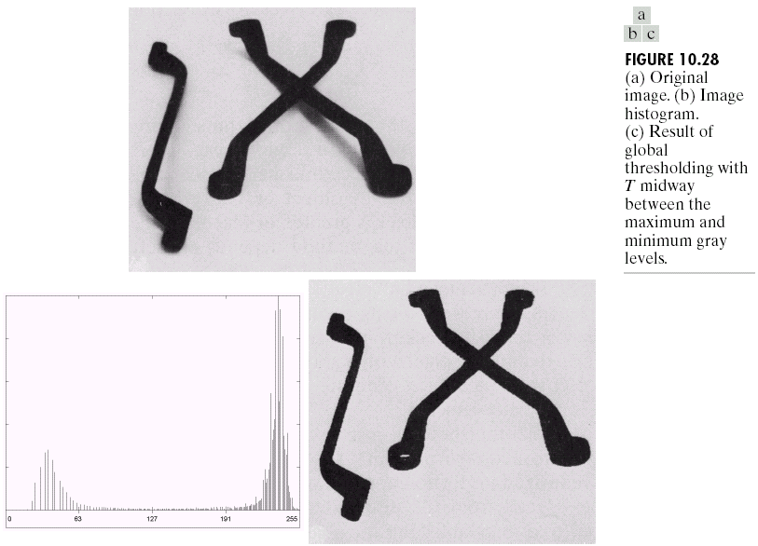
Key Stages in Digital Image Processing: Segmentation
Image Restoration
Morphological Processing
Image Enhancement
Segmentation
Image Acquisition
Object Recognition
Images taken from Gonzalez & Woods, Digital Image Processing (2002)
Representation & Description
Problem Domain
Colour Image Processing
Image Compression
Notes:
29

Slide 30
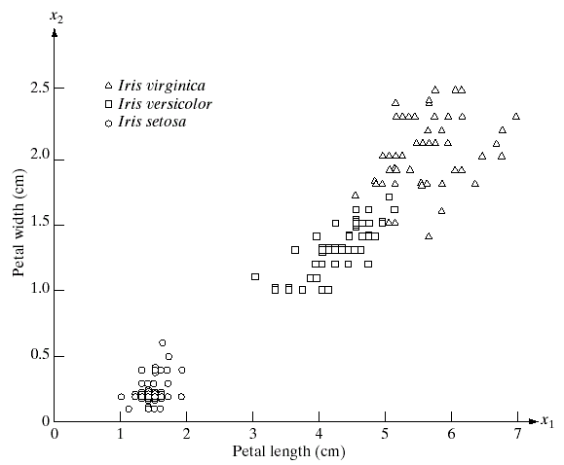
Key Stages in Digital Image Processing: Object Recognition
Image Restoration
Morphological Processing
Image Enhancement
Segmentation
Image Acquisition
Object Recognition
Images taken from Gonzalez & Woods, Digital Image Processing (2002)
Representation & Description
Problem Domain
Colour Image Processing
Image Compression
Notes:
30

Slide 31
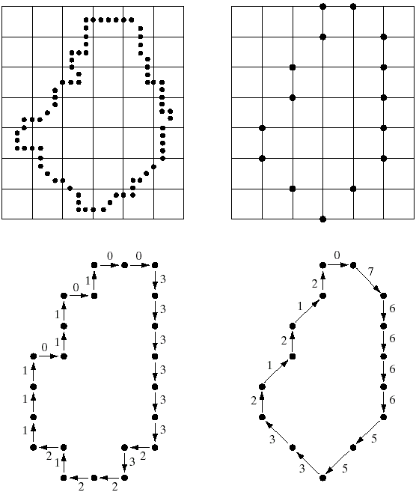
Key Stages in Digital Image Processing: Representation & Description
Image Restoration
Morphological Processing
Image Enhancement
Segmentation
Image Acquisition
Object Recognition
Images taken from Gonzalez & Woods, Digital Image Processing (2002)
Representation & Description
Problem Domain
Colour Image Processing
Image Compression
Notes:
31

Slide 32
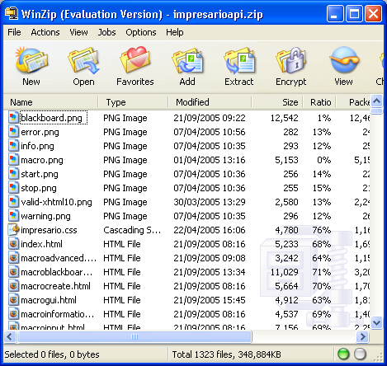
Key Stages in Digital Image Processing: Image Compression
Image Restoration
Morphological Processing
Image Enhancement
Segmentation
Image Acquisition
Object Recognition
Representation & Description
Problem Domain
Colour Image Processing
Image Compression
Notes:
32

Slide 33
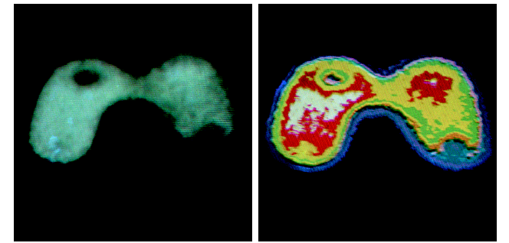
Key Stages in Digital Image Processing: Colour Image Processing
Image Restoration
Morphological Processing
Image Enhancement
Segmentation
Image Acquisition
Object Recognition
Representation & Description
Problem Domain
Colour Image Processing
Image Compression
Notes:
33

Slide 34
Summary
We have looked at:
What is a digital image?
What is digital image processing?
History of digital image processing
State of the art examples of digital image processing
Key stages in digital image processing
Notes:
34

Slide 35
Contents
This lecture will cover:
The human visual system
Light and the electromagnetic spectrum
Image representation
Image sensing and acquisition
Sampling, quantisation and resolution
Notes:
35

Slide 36
Human Visual System
The best vision model we have!
Knowledge of how images form in the eye can help us with processing digital images
We will take just a whirlwind tour of the human visual system
Notes:
36

Slide 37
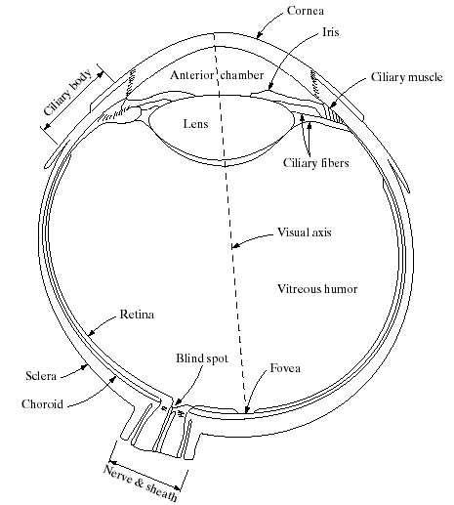

Structure Of The Human Eye
The lens focuses light from objects onto the retina
The retina is covered with light receptors called cones (6-7 million) and rods (75-150 million)
Cones are concentrated around the fovea and are very sensitive to colour
Rods are more spread out and are sensitive to low levels of illumination
Images taken from Gonzalez & Woods, Digital Image Processing (2002)
Notes:
37
Cornea and sclera keep everything in!
The choroid contains all of the blood vessels that serve as nutrition to the eye
The iris contains the pigment that gives our eyes their colour
Rods for general vison cones for details
Blind spot is where the optic nerve connects
BLIND SPOT EXPERIMENT
Women have extra cones which means they can see more colours

Slide 38

Blind-Spot Experiment
Draw an image similar to that below on a piece of paper (the dot and cross are about 6 inches apart)
Close your right eye and focus on the cross with your left eye
Hold the image about 20 inches away from your face and move it slowly towards you
The dot should disappear!
Notes:
38

Slide 39
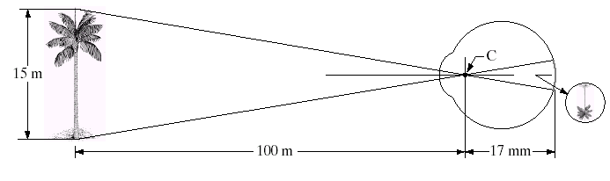
Image Formation In The Eye
Muscles within the eye can be used to change the shape of the lens allowing us focus on objects that are near or far away
An image is focused onto the retina causing rods and cones to become excited which ultimately send signals to the brain
Notes:
39

Slide 40
Brightness Adaptation & Discrimination
The human visual system can perceive approximately 10¹⁰ different light intensity levels
However, at any one time we can only discriminate between a much smaller number – brightness adaptation
Similarly, the perceived intensity of a region is related to the light intensities of the regions surrounding it
Notes:
40

Slide 41

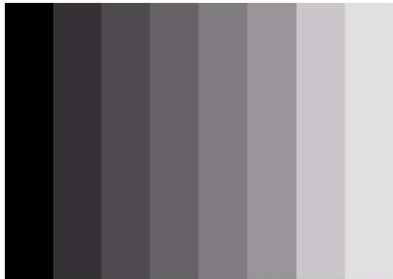
Brightness Adaptation & Discrimination (cont…)
Images taken from Gonzalez & Woods, Digital Image Processing (2002)
An example of Mach bands
Notes:
41
Mach bands were named after Ernst Mach who described the phenomenon in 1865

Slide 42
Brightness Adaptation & Discrimination (cont…)
Images taken from Gonzalez & Woods, Digital Image Processing (2002)
Notes:
42
Mach bands were named after Ernst Mach who described the phenomenon in 1865

Slide 43
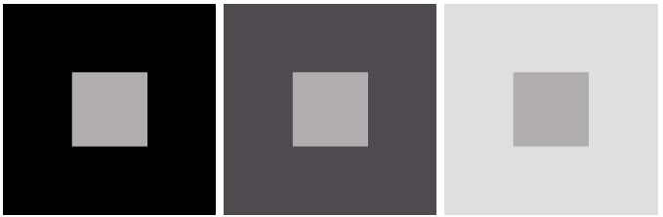
Brightness Adaptation & Discrimination (cont…)
Images taken from Gonzalez & Woods, Digital Image Processing (2002)
An example of simultaneous contrast
Notes:
43
Mach bands were named after Ernst Mach who described the phenomenon in 1865

Slide 44
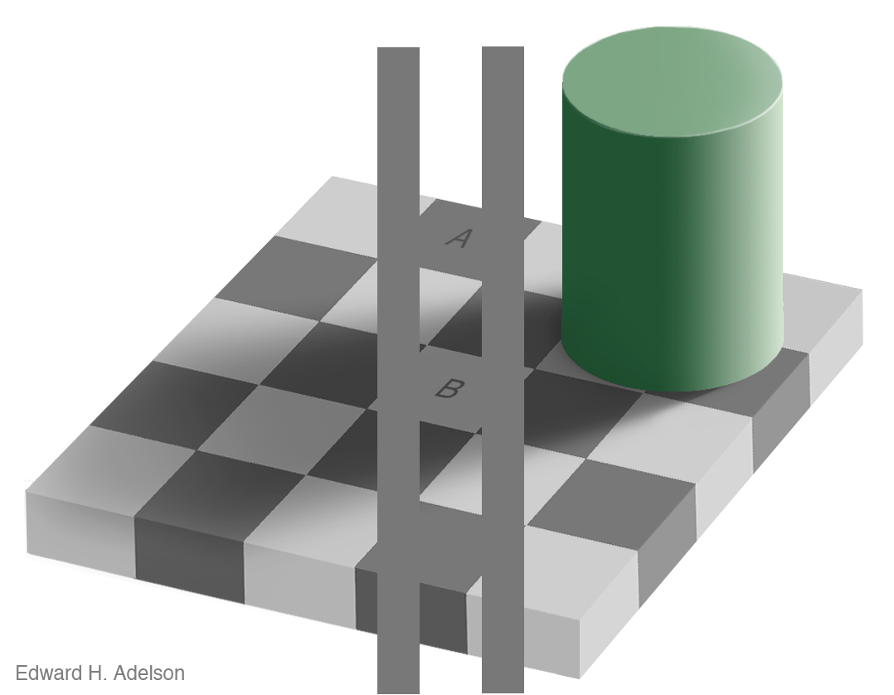
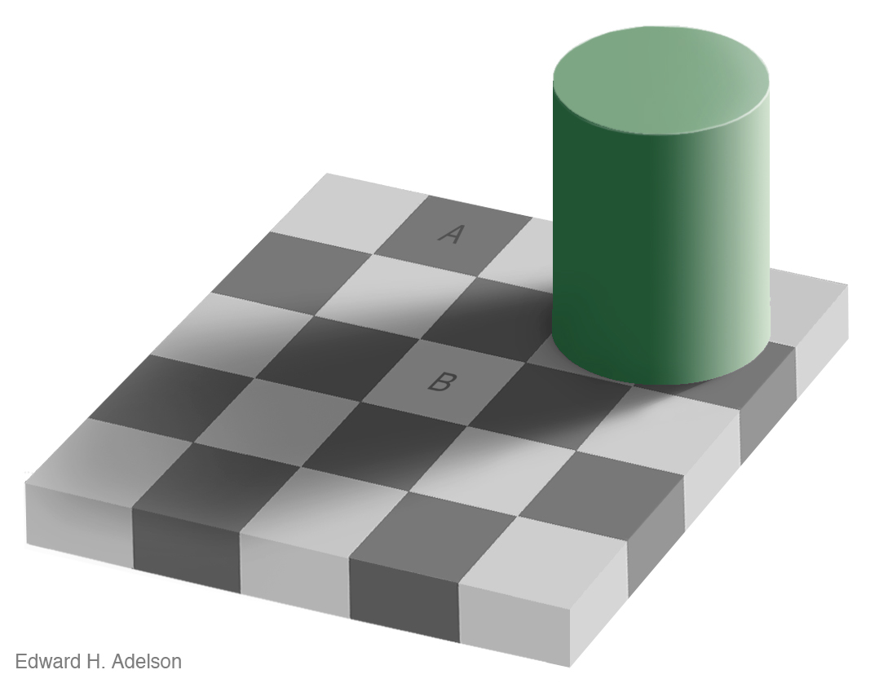
Brightness Adaptation & Discrimination (cont…)
For more great illusion examples take a look at: http://web.mit.edu/persci/gaz/
Notes:
44
Mach bands were named after Ernst Mach who described the phenomenon in 1865

Slide 45
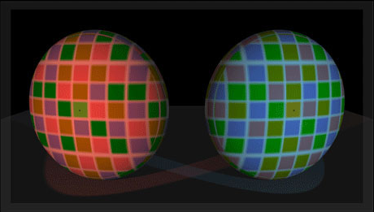
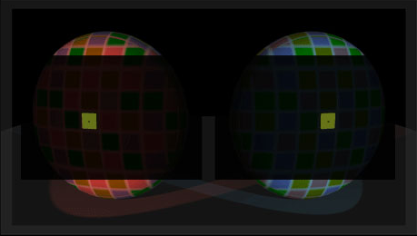
Available here: http://www.lottolab.org/Visual%20Demos/Demo%2015.html
Notes:
45

Slide 46
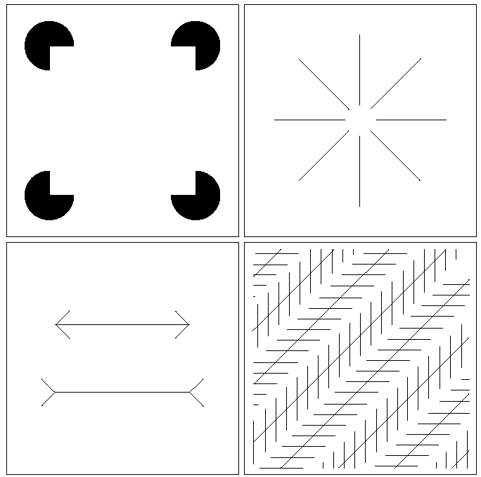
Optical Illusions
Our visual systems play lots of interesting tricks on us
Notes:
46

Slide 47
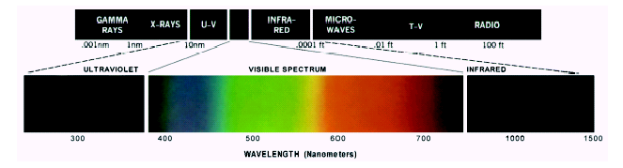
Light And The Electromagnetic Spectrum
Light is just a particular part of the electromagnetic spectrum that can be sensed by the human eye
The electromagnetic spectrum is split up according to the wavelengths of different forms of energy
Notes:
47
In 1666 Sir Isaac Newton discovered that light passed through a prism splits into a continuous spectrum of colours
Many image applications use electromagnetic radiation that is far outside the visual spectrum – x-ray images, infra-red images – we genrate images of these images by mapping them to the visual spectrum

Slide 48

Reflected Light
The colours that we perceive are determined by the nature of the light reflected from an object
For example, if white light is shone onto a green object most wavelengths are absorbed, while green light is reflected from the object
White Light
Colours Absorbed
Green Light
Notes:
48

Slide 49
Sampling, Quantisation And Resolution
In the following slides we will consider what is involved in capturing a digital image of a real-world scene
Image sensing and representation
Sampling and quantisation
Resolution
Notes:
49

Slide 50
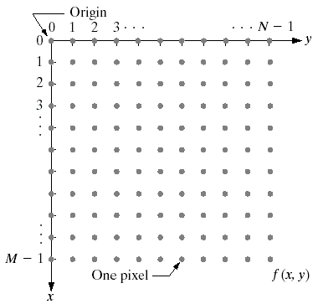
Image Representation
Before we discuss image acquisition recall that a digital image is composed of M rows and N columns of pixels each storing a value
Pixel values are most often grey levels in the range 0-255(black-white)
We will see later on that images can easily be represented as matrices
col
Images taken from Gonzalez & Woods, Digital Image Processing (2002)
f (row, col)
row
Notes:
50

Slide 51
Image Acquisition
Images are typically generated by illuminating a scene and absorbing the energy reflected by the objects in that scene
Typical notions of illumination and scene can be way off:
X-rays of a skeleton
Ultrasound of an unborn baby
Electro-microscopic images of molecules
Images taken from Gonzalez & Woods, Digital Image Processing (2002)
Notes:
51

Slide 52

Image Sensing
Incoming energy lands on a sensor material responsive to that type of energy and this generates a voltage
Collections of sensors are arranged to capture images
Images taken from Gonzalez & Woods, Digital Image Processing (2002)
Imaging Sensor
Line of Image Sensors
Array of Image Sensors
Notes:
52

Slide 53
Image Sensing
Images taken from Gonzalez & Woods, Digital Image Processing (2002)
Using Sensor Strips and Rings
Notes:
53

Slide 54

Image Sampling And Quantisation
A digital sensor can only measure a limited number of samples at a discrete set of energy levels
Quantisation is the process of converting a continuous analogue signal into a digital representation of this signal
Images taken from Gonzalez & Woods, Digital Image Processing (2002)
Notes:
54
Analogue Vs digital
Think of the volume knob on your stereo
Records Vs CDs Vs Mp3s
Nyquist theory etc talks about how much sampling we need to do

Slide 55
Image Sampling And Quantisation
Images taken from Gonzalez & Woods, Digital Image Processing (2002)
Notes:
55
Analogue Vs digital
Think of the volume knob on your stereo
Records Vs CDs Vs Mp3s
Nyquist theory etc talks about how much sampling we need to do

Slide 56
Image Sampling And Quantisation
Images taken from Gonzalez & Woods, Digital Image Processing (2002)
Notes:
56
Analogue Vs digital
Think of the volume knob on your stereo
Records Vs CDs Vs Mp3s
Nyquist theory etc talks about how much sampling we need to do

Slide 57
Image Sampling And Quantisation (cont…)
Remember that a digital image is always only an approximation of a real world scene
Images taken from Gonzalez & Woods, Digital Image Processing (2002)
Notes:
57

Slide 58
Image Representation
Images taken from Gonzalez & Woods, Digital Image Processing (2002)

Slide 59
Image Representation
Images taken from Gonzalez & Woods, Digital Image Processing (2002)

Slide 60
Image Representation
Images taken from Gonzalez & Woods, Digital Image Processing (2002)

Slide 61
Image Representation
Images taken from Gonzalez & Woods, Digital Image Processing (2002)

Slide 62

Spatial Resolution
The spatial resolution of an image is determined by how sampling was carried out
Spatial resolution simply refers to the smallest discernable detail in an image
Vision specialists will often talk about pixel size
Graphic designers will talk about dots per inch (DPI)
5.1 Megapixels
Notes:
62

Slide 63

Spatial Resolution (cont…)
Images taken from Gonzalez & Woods, Digital Image Processing (2002)
Notes:
63

Slide 64

Spatial Resolution (cont…)
Images taken from Gonzalez & Woods, Digital Image Processing (2002)
Notes:
64

Slide 65
Spatial Resolution (cont…)
Images taken from Gonzalez & Woods, Digital Image Processing (2002)
Notes:
65

Slide 66
Spatial Resolution (cont…)
Images taken from Gonzalez & Woods, Digital Image Processing (2002)
Notes:
66

Slide 67
Spatial Resolution (cont…)
Images taken from Gonzalez & Woods, Digital Image Processing (2002)
Notes:
67

Slide 68
Spatial Resolution (cont…)
Images taken from Gonzalez & Woods, Digital Image Processing (2002)
Notes:
68

Slide 69
Spatial Resolution (cont…)
Images taken from Gonzalez & Woods, Digital Image Processing (2002)
Notes:
69

Slide 70
Intensity Level Resolution
Intensity level resolution refers to the number of intensity levels used to represent the image
The more intensity levels used, the finer the level of detail discernable in an image
Intensity level resolution is usually given in terms of the number of bits used to store each intensity level
Number of Bits
Number of Intensity Levels
Examples
1
2
0, 1
2
4
00, 01, 10, 11
4
16
0000, 0101, 1111
8
256
00110011, 01010101
16
65,536
1010101010101010
Notes:
70

Slide 71


Intensity Level Resolution (cont…)
256 grey levels (8 bits per pixel)
128 grey levels (7 bpp)
64 grey levels (6 bpp)
32 grey levels (5 bpp)
Images taken from Gonzalez & Woods, Digital Image Processing (2002)
16 grey levels (4 bpp)
8 grey levels (3 bpp)
4 grey levels (2 bpp)
2 grey levels (1 bpp)
Notes:
71

Slide 72
Intensity Level Resolution (cont…)
Images taken from Gonzalez & Woods, Digital Image Processing (2002)
Notes:
72

Slide 73
Intensity Level Resolution (cont…)
Images taken from Gonzalez & Woods, Digital Image Processing (2002)
Notes:
73

Slide 74
Intensity Level Resolution (cont…)
Images taken from Gonzalez & Woods, Digital Image Processing (2002)
Notes:
74

Slide 75
Intensity Level Resolution (cont…)
Images taken from Gonzalez & Woods, Digital Image Processing (2002)
Notes:
75

Slide 76
Intensity Level Resolution (cont…)
Images taken from Gonzalez & Woods, Digital Image Processing (2002)
Notes:
76

Slide 77
Intensity Level Resolution (cont…)
Images taken from Gonzalez & Woods, Digital Image Processing (2002)
Notes:
77

Slide 78
Intensity Level Resolution (cont…)
Images taken from Gonzalez & Woods, Digital Image Processing (2002)
Notes:
78

Slide 79
Intensity Level Resolution (cont…)
Images taken from Gonzalez & Woods, Digital Image Processing (2002)
Notes:
79

Slide 80
Saturation & Noise
Images taken from Gonzalez & Woods, Digital Image Processing (2002)

Slide 81
Resolution: How Much Is Enough?
The big question with resolution is always how much is enough?
This all depends on what is in the image and what you would like to do with it
Key questions include
Does the image look aesthetically pleasing?
Can you see what you need to see within the image?
Notes:
81

Slide 82


Resolution: How Much Is Enough? (cont…)
The picture on the right is fine for counting the number of cars, but not for reading the number plate
Notes:
82

Slide 83

Intensity Level Resolution (cont…)
Images taken from Gonzalez & Woods, Digital Image Processing (2002)
Low Detail
Medium Detail
High Detail
Notes:
83

Slide 84
Intensity Level Resolution (cont…)
Images taken from Gonzalez & Woods, Digital Image Processing (2002)
Notes:
84

Slide 85
Intensity Level Resolution (cont…)
Images taken from Gonzalez & Woods, Digital Image Processing (2002)
Notes:
85

Slide 86
Intensity Level Resolution (cont…)
Images taken from Gonzalez & Woods, Digital Image Processing (2002)
Notes:
86

Slide 87
Summary
We have looked at:
Human visual system
Light and the electromagnetic spectrum
Image representation
Image sensing and acquisition
Sampling, quantisation and resolution
Next time we start to look at techniques for image enhancement
Notes:
87

Slide 88

Digital image representation
Monochrome image (or simply image) refers to a 2- dimensional light intensity function f(x,y)
– x and y denote spatial coordinates
– the value of f(x,y) at (x,y) is proportional to the brightness (or gray level) of the image at that point
Notes:
88

Slide 89
Digital image representation
A digital image is an image f(x,y) that has been discretized both in spatial coordinates and in brightness
• Considered as a matrix whose row and column indices represent a point in the image
• The corresponding matrix element value represents the gray level at that point
• The elements of such an array are referred to as: – image elements
– picture elements (pixels or pels)
Notes:
89

Slide 90
Steps in image processing
The problem domain in this example consists of pieces of mail and the objective is to read the address on each piece
Step 1: image acquisition
– Acquire a digital image using an image sensor
• a monochrome or color TV camera: produces an entire image of the problem domain every 1/30 second
• a line-scan camera: produces a single image line at a time, motion past the camera produces a 2-dimensional image
– If not digital, an analog-to-digital conversion process is required
– The nature of the image sensor (and the produced image) are determined by the application
• Mail reading applications rely greatly on line-scan cameras
• CCD and CMOS imaging sensors are very common in many applications
Notes:
90

Slide 91
Steps in image processing
• Step 2: preprocessing
– Key function: improve the image in ways that increase the chance for success of the other processes
– In the mail example, may deal with contrast enhancement, removing noise, and isolating regions whose texture indicates a likelihood of alphanumeric information
Notes:
91

Slide 92
Steps in image processing
• Step 3: segmentation
– Broadly defined: breaking an image into its constituent parts
– In general, one of the most difficult tasks in image processing
• Good segmentation simplifies the rest of the problem
• Poor segmentation make the task impossible
– Output is usually raw pixel data: may represent region boundaries, points in the region itself, etc.
• Boundary representation can be useful when the focus is on external shape characteristics (e.g. corners, rounded edges, etc.)
• Region representation is appropriate when the focus is on internal properties (e.g. texture or skeletal shape)
– For the mail problem (character recognition) both representations can be necessary
Notes:
92

Slide 93
Steps in image processing
• Step 4: representation & description
– Representation: transforming raw data into a form
suitable for computer processing
– Description (also called feature extraction) deals with extracting features that result in some quantitative information of interest or features which are basic for differentiating one class of objects from another
– In terms of character recognition, descriptors such as lakes (holes) and bays help differentiate one part of the alphabet from another
Notes:
93

Slide 94
Steps in image processing
• Step 5: recognition & interpretation
– Recognition: The process which assigns a label to an object based on the information provided by its descriptors
A may be the alphanumeric character A
– Interpretation: Assigning meaning to an ensemble of recognized objects
35487-0286 may be a ZIP code
Notes:
94

Slide 95

Steps in image processing
Notes:
95

Slide 96
Steps in image processing
Notes:
96

Slide 97
A Knowledge Base
• Knowledge about a problem domain is coded into an image processing system in the form of a knowledge database
– May be simple:
• detailing areas of an image expected to be of interest
– May be complex
• A list of all possible defects of a material in a vision inspection system
– Guides operation of each processing module
– Controls interaction between modules
– Provides feedback through the system
Notes:
97

Slide 98
Steps in an image processing system
• Not all image processing systems would require all steps/processing modules
– Image enhancement for human visual perception may not go beyond the preprocessing stage
• A knowledge database may not be required
• Processing systems which include recognition and interpretation are associated with image analysis systems in which the objective is autonomous (or at least partially automatic)
Notes:
98

Slide 99
A simple imaging model
• An image is a 2-D light intensity function f(x,y)
• As light is a form of energy
0 < f(x,y) < ∞
• f(x,y) may be expressed as the product of 2 components f(x,y)=i(x,y)r(x,y)
• i(x,y) is the illumination: 0 < i(x,y) < ∞
– Typical values: 9000 foot-candles sunny day, 100 office room, 0.01 moonlight
• r(x,y) is the reflectance: 0 < r(x,y) < 1
– r(x,y)=0 implies total absorption
– r(x,y)=1 implies total reflectance
– Typical values: 0.01 black velvet, 0.80 flat white paint, 0.93 snow
Notes:
99

Slide 100
A simple imaging model
• The intensity of a monochrome image f at (x,y) is the gray level (l) of the image at that point
• In practice Lmin=imin rmin and Lmax=imax rmax
• As a guideline Lmin ≈ 0.005 and Lmax ≈ 100 for indoor image processing applications
• The interval [Lmin, Lmax] is called the gray scale
• Common practice is to shift the interval to [0,L] where l=0 is considered black and l=L is considered white. All intermediate values are shades of gray
Notes:
100

Slide 101

Sampling and Quantization
• To be suitable for computer processing an image, f(x,y) must be digitized both spatially and in amplitude
• Digitizing the spatial coordinates is called image sampling
• Amplitude digitization is called gray-level quantization
• f(x,y) is approximated by equally spaced samples in the form of an NxM array where each element is a discrete quantity
Notes:
101

Slide 102

Sampling and Quantization
• Common practice is to let N and M be powers of two; N=2^n and M=2^k
• And G=2^m where G denotes the number of gray levels
• The assumption here is that gray levels are equally space in the interval [0,L]
• The number of bits, b, necessary to store the image is then
• For example, a 128x128 image with 64 gray levels would require 98,304 bits of storage
Notes:
102

Slide 103

Sampling and Quantization
• How many samples and gray levels are required for a “good” approximation?
• The resolution (the degree of discernible detail) depends strongly on these two parameters
Notes:
103

Slide 104

Effects of reducing spatial resolution
Notes:
104

Slide 105

Effects of reducing gray levels
Notes:
105

Slide 106
Basic relationships between pixels
An image is denoted by: f(x,y)
Lowercase letters (e.g. p, q) will denote individual pixels
A subset of f(x,y) is denoted by S
Neighbors of a pixel:
– A pixel p at (x,y) has 4 horizontal/vertical neighbors at
• (x+1,y),(x-1,y),(x,y+1)and(x,y-1)
• called the 4-neighbors of p: N4(p)
– A pixel p at (x,y) has 4 diagonal neighbors at
• (x+1,y+1),(x+1,y-1),(x-1,y+1)and(x-1,y-1)
• called the diagonal–neighbors of p:ND(p)
– The 4-neighbors and the diagonal-neighbors of p are called the 8-neighbors of p: N8(p)
Notes:
106

Slide 107

Connectivity between pixels
• Connectivity is an important concept in establishing boundaries of object and components of regions in an image
• When are two pixels connected?
– If they are adjacent in some sense (say they are 4-neighbors)
– and, if their gray levels satisfy a specified criterion of similarity (say they are equal)
• Example: given a binary image (e.g. gray scale = [0,1]), two pixels may be 4-neighbors but are not considered connected unless they have the same value
Notes:
107

Slide 108
Connectivity between pixels
• Let V be the set of values used to determine connectivity
– For example, in a binary image, V={1} for the connectivity of pixels
with a value of 1
– In a gray scale image, for the connectivity of pixels with a range of
intensity values of, say, 32 to 64, it follows that V={32,33,...,63,64}
– Consider three types of connectivity
• 4-connectivity: Pixels p and q with values from V are 4-connected if q is in the set N4(p)
• 8-connectivity: Pixels p and q with values from V are 8-connected if q is in the set N8(p)
• m-connectivity (mixed): Pixels p and q with values from V are
m-connected if
– q is in the set N4(p),or
– q is in the set ND(p) and the set N4(p) ∩ N4(q) is empty (This is the set of pixels that are 4-neighbors of p and q and whose values are from V)
Notes:
108

Slide 109

Connectivity between pixels
Notes:
109

Slide 110
Pixel adjacencies and paths
• Pixel p is adjacent to q if they are connected
– We can define 4-, 8-, or m-adjacency depending on the specified type of connectivity
• Two image subsets S1 and S2 are adjacent if some pixel in S1 is adjacent to S2
• A path from p at (x,y) to q at (s,t) is a sequence of distinct pixels with coordinates (x0,y0), (x1,y1),....., (xn,yn)
– Where (x0,y0)=(x,y) and (xn,yn)=(s,t) and
– (xi,yi) is adjacent to (xi-1,yi-1) for 1<= i <= n
– n is the length of the path
• If p and q are in S, then p is connected to q in S if there is a path from p to q consisting entirely of pixels in S
Notes:
110

Slide 111

Example paths
Notes:
111

Slide 112

Connected components
• For any pixel p in S, the set of pixels connected to p form a connected component of S
• Distinct connected components in S are said to be disjoint
Notes:
112

Slide 113

Labeling 4-connected components
• Consider scanning an image pixel by pixel from left to right and top to bottom
– Assume, for the moment, we are interested in 4-connected components
– Let p denote the pixel of interest, and r and t denote the upper and left neighbors of p, respectively
– The nature of the scanning process assures that r and t have been encountered (and labeled if 1) by the time p is encountered
Notes:
113

Slide 114
Labeling 4-connected components
• Consider the following procedure
if p=0 continue to the next position
if r=t=0 assign a new label to p (Ln)
if r=t=1 and they have the same label, assign that label to p
if only one of r and t are 1, assign its label to p
if r=t=1 and they have different labels, assign one label to p and note that the two labels are equivalent (that is r and t are connected through p)
At the end of the scan, sort pairs of equivalent labels into equivalence classes and assign a different label to each class
Notes:
114

Slide 115

Labeling 4-connected components (example)
Notes:
115

Slide 116

Labeling 8-connected components
• Proceed as in the 4-connected component labeling case, but also examine two upper diagonal neighbors (q and s) of p
Notes:
116

Slide 117

Labeling connected components in non-binary images
• The 4-connected or 8-connected labeling schemes can be extended to gray level images
• The set V may be used to connect into a component only those pixels within a specified range of pixel values
Notes:
117

Slide 118

Distance measures
• Given pixels p, q, and z at (x,y), (s,t) and (u,v) respectively,
• D is a distance function (or metric) if:
– D(p,q) ≥ 0 (D(p,q)=0 iff p=q),
– D(p,q) = D(q,p), and
– D(p,z) ≤ D(p,q) + D(q,z).
• The Euclidean distance between p and q is given by:
• The pixels having distance less than or equal to some value r from (x,y) are the points contained in a disk of radius r centered at (x,y)
Notes:
118

Slide 119


Distance measures
• The D4 distance (also called the city block distance) between p and q is given by:
• The pixels having a D4 distance less than some r from (x,y)
form a diamond centered at (x,y)
• Example: pixels where D4 ≤ 2
Notes:
119

Slide 120

Distance measures
• The D8 distance (also called the chessboard distance) between p and q is given by:
• The pixels having a D8 distance less than some r from (x,y)
form a square centered at (x,y)
• Example: pixels where D8 ≤ 2
Notes:
120

Slide 121
Distance measures and connectivity
• The D4 distance between two points p and q is the shortest 4-path between the two points
• The D8 distance between two points p and q is the shortest 8-path between the two points
• D4 and D8 may be considered, regardless of whether a connected path exists between them, because the definition of these distances involves only the pixel coordinates
• For m-connectivity, the value of the distance (the length of the path) between two points depends on the values of the pixels along the path
Notes:
121

Slide 122

Distance measures and m-connectivity
• Consider the given arrangement of pixels and assume
– p, p2 and p4 =1
– p1 and p3 can be 0 or 1
• If V={1} and p1 and p3 are 0, the m-distance (p, p4) is 2 If either p1 or p3 are 1, the m-distance (p, p4) is 3 If p1 and p3 are 1, the m-distance (p, p4) is 4
Notes:
122

Slide 123

M-connectivity example
Notes:
123

Slide 124
Arithmetic & logic operations
• Arithmetic & logic operations on images used extensively in most image processing applications
– May cover the entire image or a subset Arithmetic operation between pixels p and q are defined as:
– Addition: (p+q)
• Used often for image averaging to reduce noise
– Subtraction: (p-q)
• Used often for static background removal
– Multiplication: (p*q) (or pq, p×q)
• Used to correct gray-level shading
– Division: (p÷q) (or p/q)
• As in multiplication
Notes:
124

Slide 125
Logic operations
• Arithmetic operation between pixels p and q are defined as:
– AND: p AND q (also p⋅q)
– OR: p OR q (also p+q)
– COMPLEMENT: NOTq (also q’)
• Form a functionally complete set
• Applicable to binary images
• Basic tools in binary image processing, used for:
– Masking
– Feature detection
– Shape analysis
Notes:
125

Slide 126

Examples of logic operations
Notes:
126

Slide 127

Examples of logic operations
Notes:
127

Slide 128
Neighborhood-oriented operations
• Arithmetic and logical operations may take place on a subset of the image
– Typically neighborhood oriented
• Formulated in the context of mask operations (also
called template, window or filter operations)
• Basic concept:let the value of a pixel be a function of its (current) gray level and the gray level of its neighbors (in some sense)
Notes:
128

Slide 129


Neighborhood-oriented operations
• Consider the following subset of pixels in an image
• Suppose we want to filter the image by replacing the value at Z5 with the average value of the pixels in a 3x3 region centered around Z5
• Perform an operation of the form:
• and assign to z5 the value of z
Notes:
129

Slide 130



Neighborhood-oriented operations
• In the more general form, the operation may look like:
• This equation is widely used in image processing
• Proper selection of coefficients (weights) allows for operations such as
– noise reduction
– region thinning
– edge detection
Notes:
130

